Slide 1
Data Spark Illuminating Insights for Global Electronics
Presented by,
Monika A

Slide 2
COMPANY
Global Electronics, a leading retailer of consumer electronics, has provided with several datasets containing information about their customers, products, sales, stores, and currency exchange rates.
The company seeks to leverage this data to better understand their business and identify areas for improvement.
PROBLEM STATEMENT
As part of Global Electronics' data analytics team, I have tasked with conducting a comprehensive Exploratory Data Analysis (EDA) to uncover valuable insights from the company’s data.
The goal is to provide actionable recommendations that can enhance customer satisfaction, optimize operations, and drive overall business growth.

Slide 3
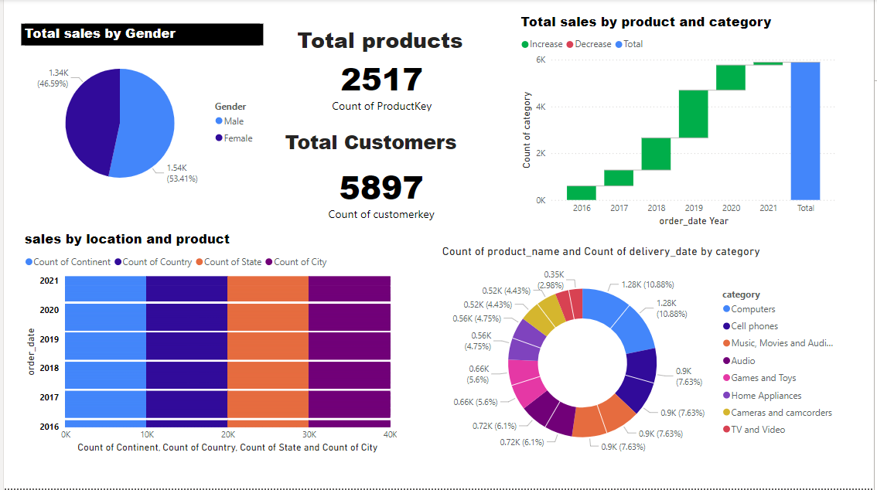

Slide 4
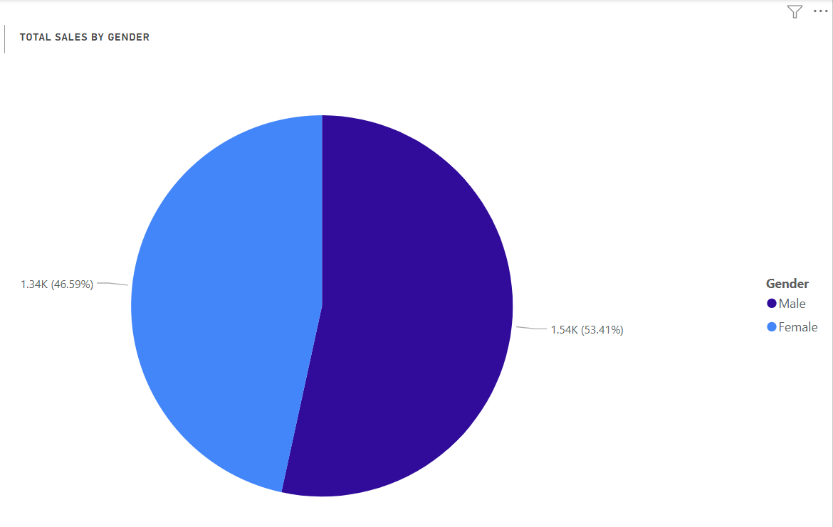

Slide 5
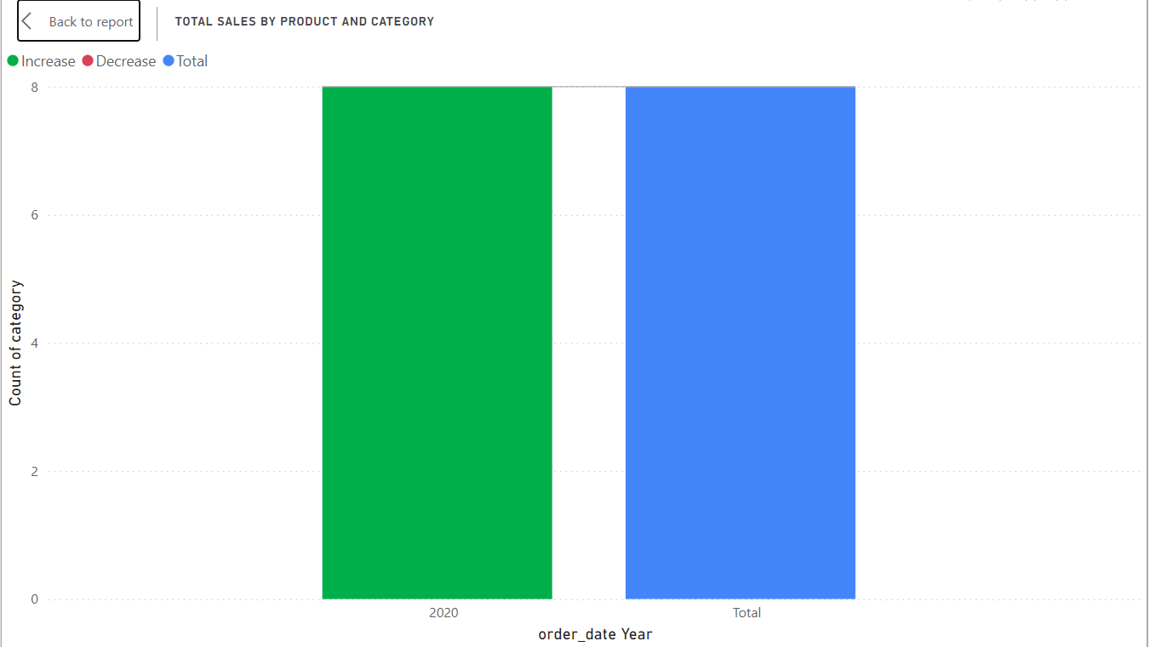

Slide 6
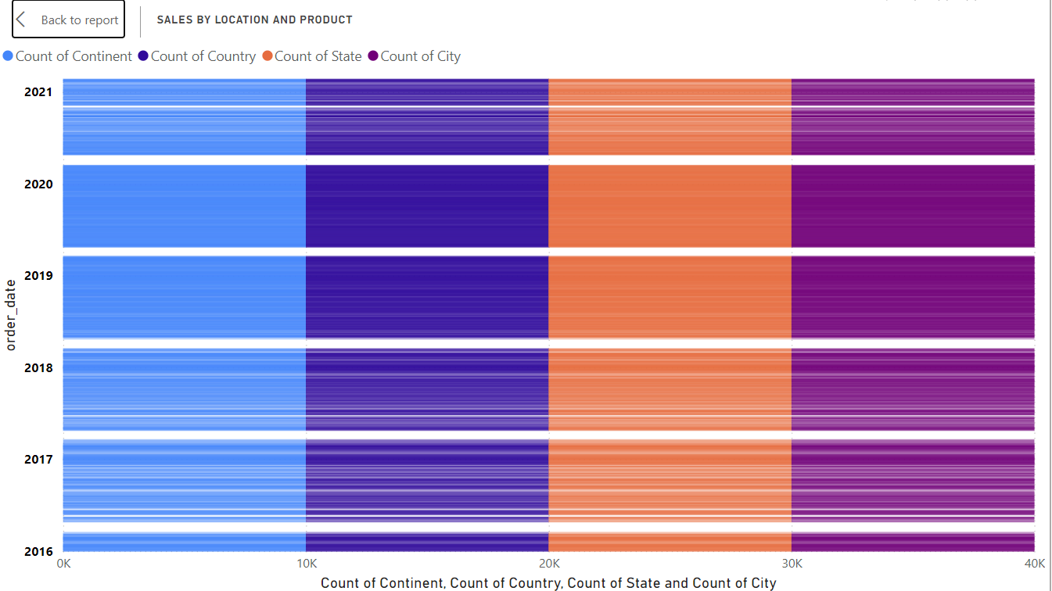

Slide 7
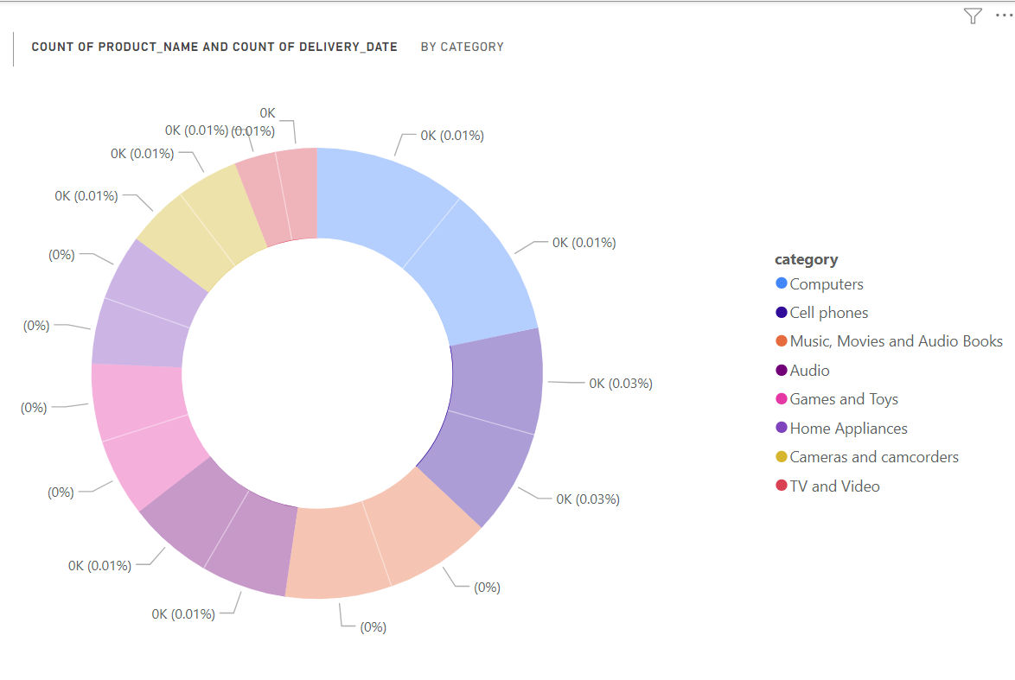

Slide 8
approach
Handling Missing Values: Check for and address any missing data.
Data Type Conversion: Ensure data types are consistent and accurate (e.g., dates, numerical values).
Data Merging: Combine relevant datasets (e.g., linking sales data with product and customer data).

Slide 9
Data Management Using SQL
Database Insertion: Load the preprocessed data into an SQL database by creating tables for each data source.
SQL Queries: Formulate and execute 10 key SQL queries to extract insights. Power BI/Tableau Visualization 1.Data Import: Connect SQL to Power BI/Tableau and import the cleaned data. 2.Dashboard Creation: Develop interactive dashboards to visualize key findings. Analysis Steps
Customer Analysis
Demographic Distribution: Analyze customer demographics by gender, age, and location.
Purchase Patterns: Identify average order value, purchase frequency, and product preferences.
Segmentation: Segment customers based on behavior and demographics.

Slide 10
Sales Analysis
Overall Sales Performance: Analyze total sales trends over time.
Sales by Product: Determine top-performing products.
Sales by Store: Assess performance across different stores.
Sales by Currency: Evaluate the impact of currency exchange rates on sales.
Product Analysis
Product Popularity: Identify best-selling and least popular products.
Profitability Analysis: Calculate profit margins by comparing costs and prices.
Category Analysis: Analyze sales across different product categories.
Store Analysis
Store Performance: Evaluate stores based on sales and operational data.
Geographical Analysis: Identify high-performing regions based on store locations.

Slide 11
Result
Upon completion, this project will deliver a comprehensive EDA report for Global Electronics,featuring
Cleaned and integrated datasets.
In-depth insights into customer demographics, purchasing behaviors, product performance, store operations, and the impact of currency exchange rates on sales.
Visually compelling dashboards and visualizations.
Actionable recommendations to enhance marketing strategies, optimize inventory management, improve sales forecasting, and guide product development and store operations. These insights will empower Global Electronics to increase customer satisfaction, maximize revenue, and drive overall business growth.

